Slide 1
Caption Metrics
Dylan Christoffels & Tian Wells
Notes:
dylan

Slide 2
Initial Research on Caption Comprehension
At the beginning of our research, we focused on the comprehension of captions.
We found several experiments from other countries that had participants watch TV shows. There were two groups: one with captions and other without. The results showed us how important captions are.
We also found that DHH people often prefer verbatim captions over edited captions, even though they take longer to read. This is because they prefer to have more accurate and comprehensible captions over shorter ones (this differs with different levels of literacy).
Rodgers & Webb (2017)
Szarkowska, Krejtz, Klyszejko, & Wieczorek (2011)
Notes:
Dylan
Verbatim is regular conversation captioning
Edited is shorter version to speed up.
Literacy is able to read and write

Slide 3
Live Captioning Research
Then we focused on live captions instead, TV shows or movies, since the data we already have is on live TV.
Caption metrics more often are used on live captions since they were created by people (using stenography) or translated by speech recognition (using respeaking and/or ASR), making them more prone to errors.
Stats show that closed-captions in the broadcast news contain an average of 17% word error rate.
Jang & Hauptmann (1999)
Notes:
dylan

Slide 4
Different Caption Metrics
Metrics numerically compare what is actually spoken (transcript) with the captions
WER (Word Error Rate)
Penalizes words that are incorrect, due to a mistake in one of the three categories: insertion, deletion, or replacement.
Errors are not weighted based on severity
WWER (Weighted Word Error Rate)
Based on WER, except errors are weighted on severity.
There are 17 error types that each have a weight. Each of the 17 types belongs to one of the 3 WER error types.
Al Amin (2020)
Apone, Brooks, & O’Connell (2010)
Notes:
tian

Slide 5
Different Caption Metrics
NER
Semi-automatic metric that needs a human expert to weigh errors
Mostly used for live caption evaluation
Two error types: edition and recognition
Three severity levels: Minor, Standard, Serious
ACE
Evaluated ASR-generated captions specifically for DHH people
Unlike WER, distinguished between harmful and less harmful errors
Uses word predictability score to measure keywords in a text, and semantic distance to approximate deviation
Kafle & Huenerfauth (2017)
Romero-Fresco & Martinez (2015)
Notes:
tian

Slide 6
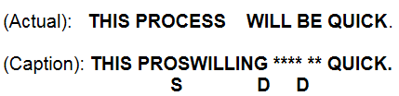
How to calculate caption metrics like WER?
There are three error types:
Substitution - one error word that substituted for a correct word in reference transcript.
Deletion - One word that has been deleted or omitted from the transcript.
Insertion - One word has been inserted into the transcript that wasn’t spoken.
WER = (Sub + Del + Ins) / N
The N is the total number of words in the reference transcript.
“This identifies the errors more clearly. There is one substitution (“PROSWILLING” has been substituted for “PROCESS”) and two deletions (WILL and BE have been left out).”
“Using the WER formula, there are 3 errors out of 5 words, or a 60% Word Error Rate.” (p.4)
Apone, Brooks, & O’Connell (2010).
Notes:
dylan

Slide 7
What do we not know or need to know?
In our research, we found that although there are many different caption metrics out there, there is little to no research exploring how these metrics compare to each other.
This makes it harder to make an informed decision about which caption metric to use and when.
We found research comparing WER and ACE when used for ASR-generated captions. The result was that ACE performed better in correlation to user experiences.
We still don’t know how these caption metrics would compare when used for live TV captioning.
Kafle & Huenerfauth (2017)
Notes:
tian

Slide 8
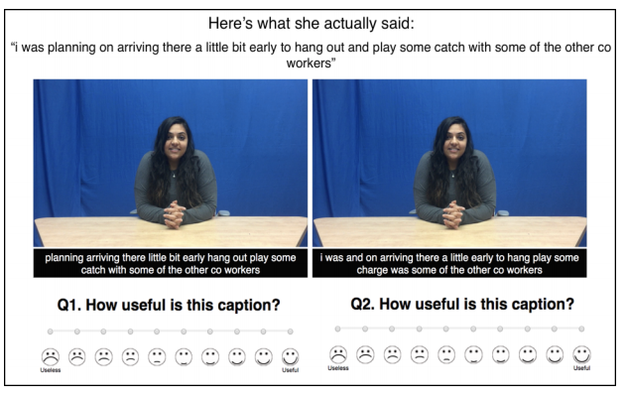
Research Question:
How accurately do the WER/WWER/NER/ACE2 models assess the quality of live TV captions when compared to each other?
Idea for our evaluation plan:
Evaluate our live TV captioning data with the metrics
Write a code that will find parts of the captioning where the different metrics conflict the most
Test participants will need to rank the quality of the chosen clips/captions
Notes:
tian

Slide 9
References
Al Amin, A. (2020). Audio-Visual Caption Evaluation Metric for People who are Deaf and Hard of Hearing.
Apone, T., Brooks, M., & O’Connell, T. (2010). Caption Accuracy Metrics Project. Caption Viewer Survey: Error Ranking of Real-time Captions in Live Television News Programs. Boston.
Jang, P. J., & Hauptmann, A. G. (1999, June). Improving acoustic models with captioned multimedia speech. In Proceedings IEEE International Conference on Multimedia Computing and Systems (Vol. 2, pp. 767-771). IEEE.
Kafle, S., & Huenerfauth, M. (2017, October). Evaluating the usability of automatically generated captions for people who are deaf or hard of hearing. In Proceedings of the 19th International ACM SIGACCESS Conference on Computers and Accessibility (pp. 165-174).
Rodgers, M., & Webb, S. (2017). The Effects of Captions on EFL Learners’ Comprehension of English-Language Television Programs. CALICO Journal, 34(1), 20-38. Retrieved May 18, 2021, from https://www.jstor.org/stable/90014676
Romero-Fresco, Pablo. (2015). Accuracy Rate in Live Subtitling: The NER Model. 10.1057/9781137552891_3.
Szarkowska, A., Krejtz, I., Klyszejko, Z., & Wieczorek, A. (2011). Verbatim, standard, or edited? Reading patterns of different captioning styles among deaf, hard of hearing, and hearing viewers. American Annals of the Deaf 156 (4), 363–378.
Notes:
dylan

